Slide 1
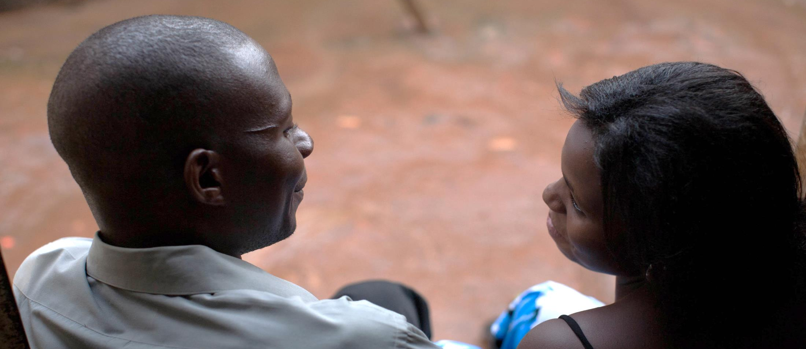




SASA! Study Results
understanding the impact of preventing violence against women and HIV

Slide 2
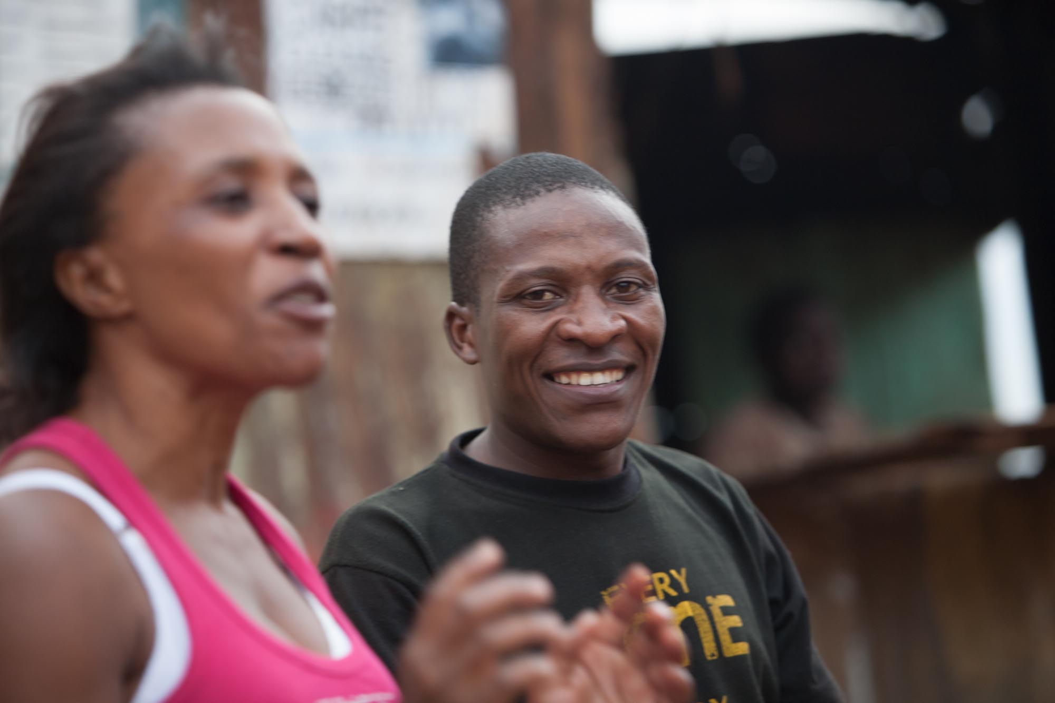
Violence is preventable

Slide 3
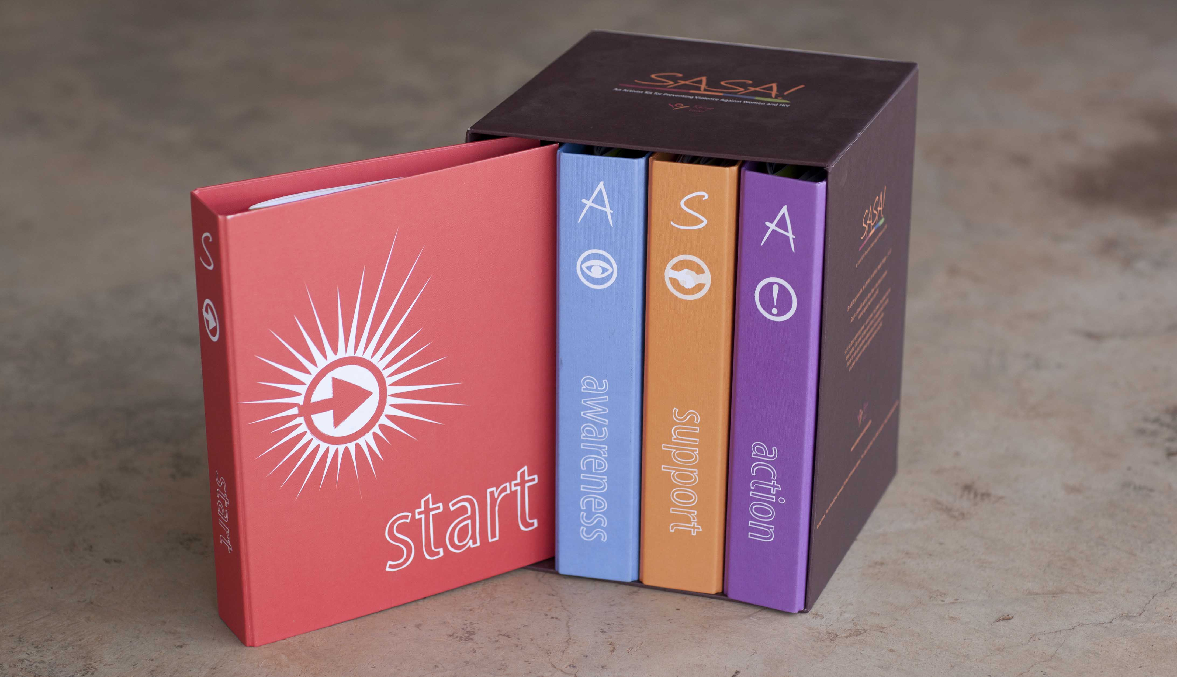
developed by Raising Voices
community mobilization approach
changing social norms that perpetuate violence against women and HIV
The SASA ! Activist Kit

Slide 4
The SASA! Approach: How it works
Start
Awareness
Support
Action
Action
Awareness
Support
involving community members, leaders and institutions to build critical mass

Slide 5

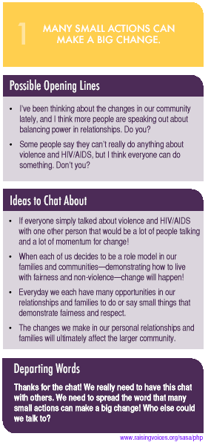
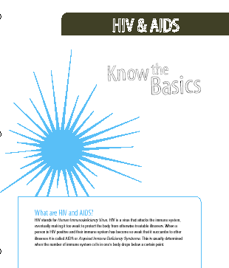
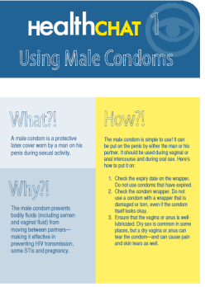
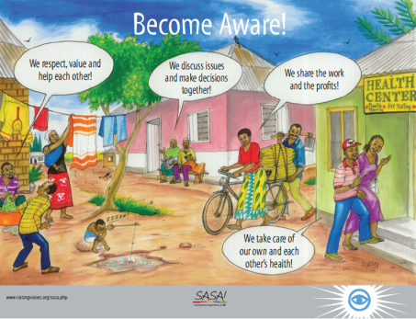
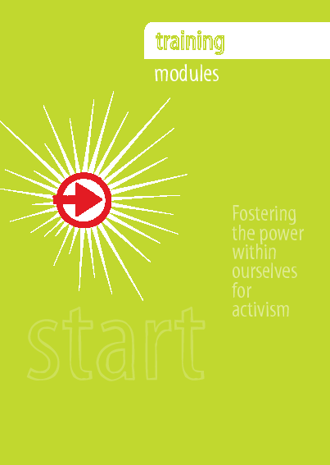
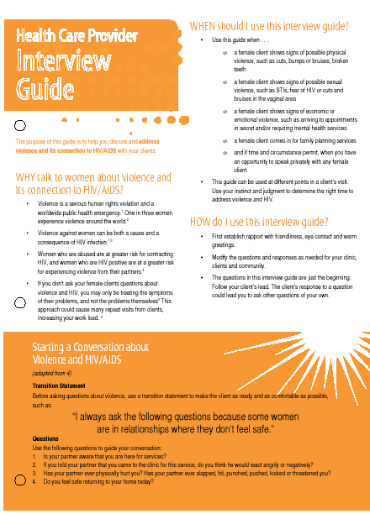
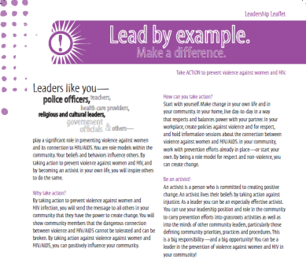
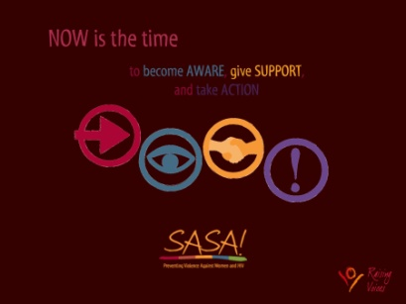
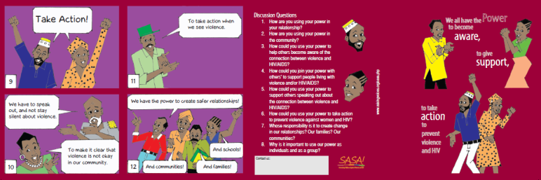
SASA! Strategies
Multiple strategies to reach out to all levels in the community to affect social norm change
Local Activism
Media and Advocacy
Communication Materials
Training
Content evolves with each phase

Slide 6
Three critical components of SASA!
Process
  phasing in ideas systematically
  lead by community members
Reach
  creating critical mass across all sectors
  multiple strategies for intense exposure
Content
  language of power is provocative
  decreases defensiveness, gets personal

Slide 7
SASA! in Kampala
Over 400 activists
‘regular’ women and men in community, local government and cultural leaders, ssengas, police, health care providers, drama activists, youth, etc
leading over 11,000 activities
community conversations, door-t0-door discussions, quick chats, trainings, public events, poster discussions, community meetings, film shows, soap opera groups, etc
reaching more than 260,000 community members in 6 parishes in Makindye and Rubaga

Slide 8
SASA! Study Overview
Cluster Randomized Controlled Trial
Baseline: 1583 respondents
717 female 866 male
Follow up: 2649 respondents
1181 female 1468 male
Qualitative Research
Baseline: 64 in-depth interviews and
12 FGDs
Follow up: 92 in-depth interviews
Operations Research
6000+ process reports
750+ impact monitoring
6 rapid assessment surveys
Costing Study
Economic costing

Slide 9
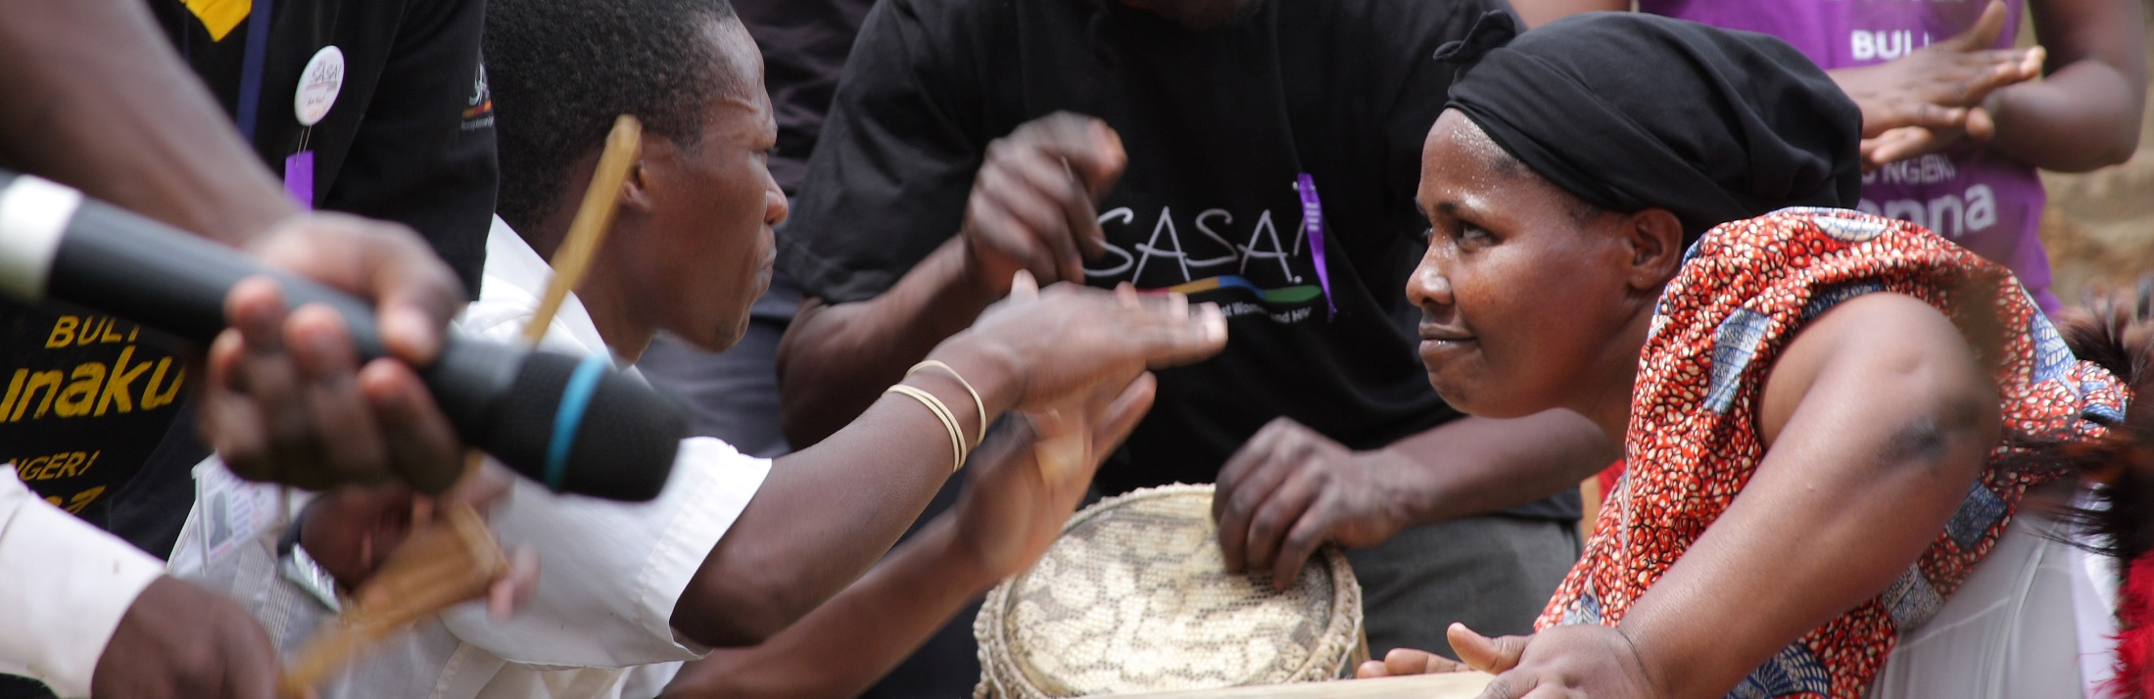
The SASA! study breaks new ground
Current evidence that violence is preventable assesses the impact among the direct recipients of intervention programs
First trial in sub-Saharan Africa to assess impact at community level of a VAW prevention intervention

Slide 10
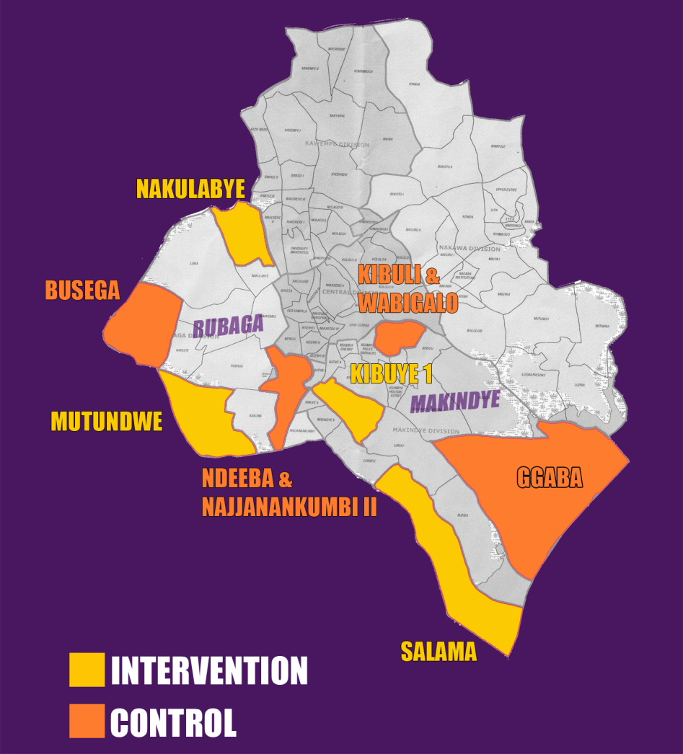
Cluster Trial Design
4 intervention & 4 control communities
Baseline 2008
Follow Up 2012
2.8 years of programming from
May 2008 – December 2012
  (programming suspended during periods of political unrest)
KAMPALA DISTRICT

Slide 11
Primary Outcomes
Acceptability of men’s use of physical violence against their partner (women, men)
Acceptability of when a woman can refuse sex (women, men)
Experience of physical acts of violence from partner in past year (women)
Women’s perceptions of appropriateness of responses experienced (women)
Reported sexual concurrency in past year among men (men)

Slide 12
Trends in Outcomes
 | Expected | Observed
Acceptability of men’s use of physical violence against their partner (women*, men)
Acceptability that there are circumstances when a woman can refuse sex (women*, men*)
Experience of physical acts of violence from partner in past year (women*)
Women’s perceptions of appropriateness of responses to violence received*
Reported sexual concurrency in past year by men*
*Significant or borderline significant in intention to treat or per protocol analysis

Slide 13
SASA ! changed what people believe…

Slide 14
Reduced social acceptance of physical violence in relationships*
Percentage of women and men who believe physical
violence against a partner is not acceptable*
76%
26%
In SASA! Communities
In Control Communities
* Statistically significant
“I have to behave well [and intervene in violence] with the help of groups like SASA! and the police, government in general. However, I should be the first person to prevent the violence in the community.” Male community member
In the past we would just ignore if a man beat his wife but now I think it is not okay to ignore ...” Female community member

Slide 15
In SASA! communities, 28% more women and men believe it is acceptable for a woman to refuse sex than women and men in control communities.*
* Statistically significant
“[from attending SASA! activities] I learned that some of the things I used to do were not right at all...for instance I thought that whenever I needed sex I had to have it without her denying me. I thought whenever I wanted sex, she would automatically want it. So whenever she would refuse, I would get so enraged and we would fight” Male community member

Slide 16
SASA! changed how people behave…

Slide 17
Levels of physical partner violence against women 52% lower in
SASA! communities than in control communities*
* Borderline significance in per protocol analysis
“I feel so proud of my marriage at this moment…now people admire us and
our children…We do not quarrel neither do we use violence against our children…” Female community member
“When it comes to me I have changed a lot. I no longer beat her as I used to,
I no longer use abusive language on her…” Male community member

Slide 18
Women exposed to SASA! 3 times more likely to receive helpful support
than women not exposed to SASA!*
* Borderline significance in per protocol analysis
“Personally I was going through violence but I did not know what to do and where to go but when SASA! came, I realized I had support”
Female community member
“Well this program is so good especially for us women. Before this program… a man could beat you up or use any form of violence against a woman…but now we have a voice and they [services, police] listen to us”
Female community member

Slide 19
Lower levels of sexual concurrency among men in SASA! communities than in control communities*
27%
45%
In SASA! Communities
In Control Communities
* Statistically significant
“I think he became more faithful and I think he is still faithful because he has attended so many SASA! activities. You know you might start a relationship very well but then it can fail after sometime but I think because my husband has been exposed to SASA! this has helped him to be a good man.”
Female community member

Slide 20
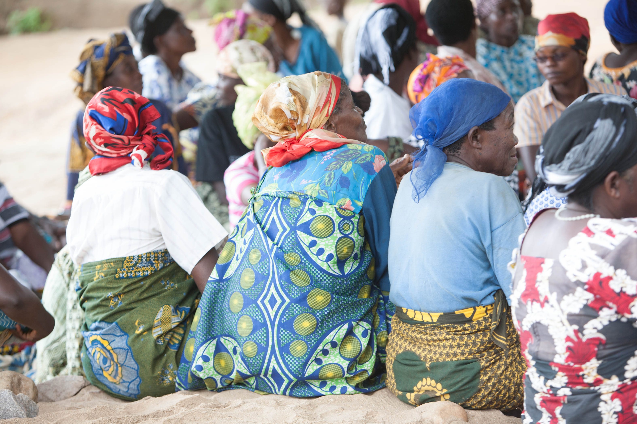
Programmatic learning
What’s working
  Community-led activism
  Focus on critical consciousness
  Benefits-based, aspirational framing
  Language of power

Slide 21
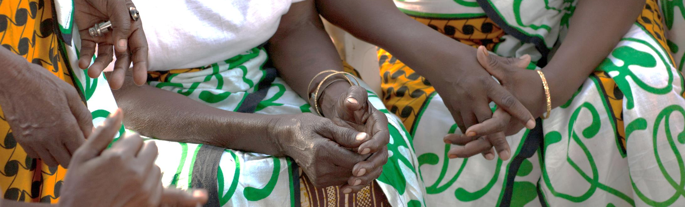
Programmatic learning
What’s not working
  Overemphasis on gender roles
  Inclusion of diverse types of violence against women

Slide 22
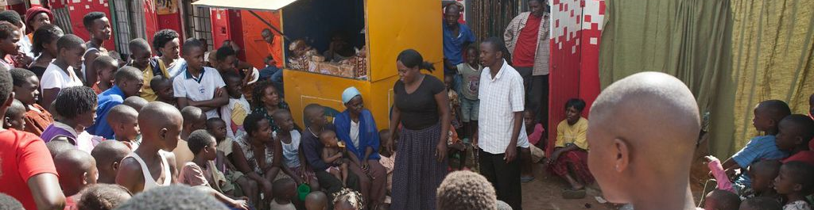
Learning for the VAW prevention field
Invest in social norm change interventions at the community level
Meaningful community impact can happen within project timeframes
Intensity of programming important
    A combination of communication channels are important
    Requires strong organizational capacity to provide sustained support to community-led activities

Slide 23
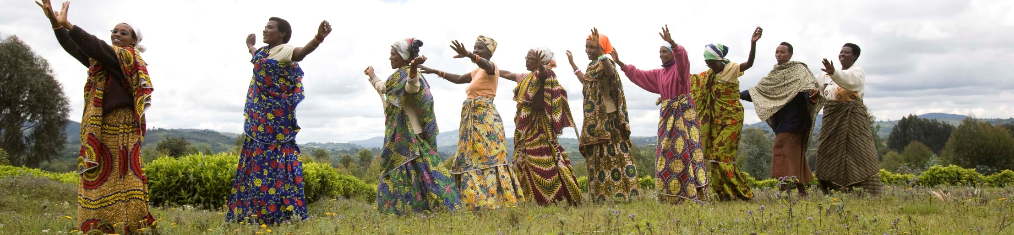
Moving forward with SASA!
Implemented in control communities
Currently being used in 15 countries in sub-Saharan Africa by over 50 organizations
Used by Government of Uganda in 8 districts of Busoga
Implemented in diverse settings by diverse groups
Major adaptations underway in Haiti, Mongolia, Ethiopia and for faith-based communities.

Slide 24
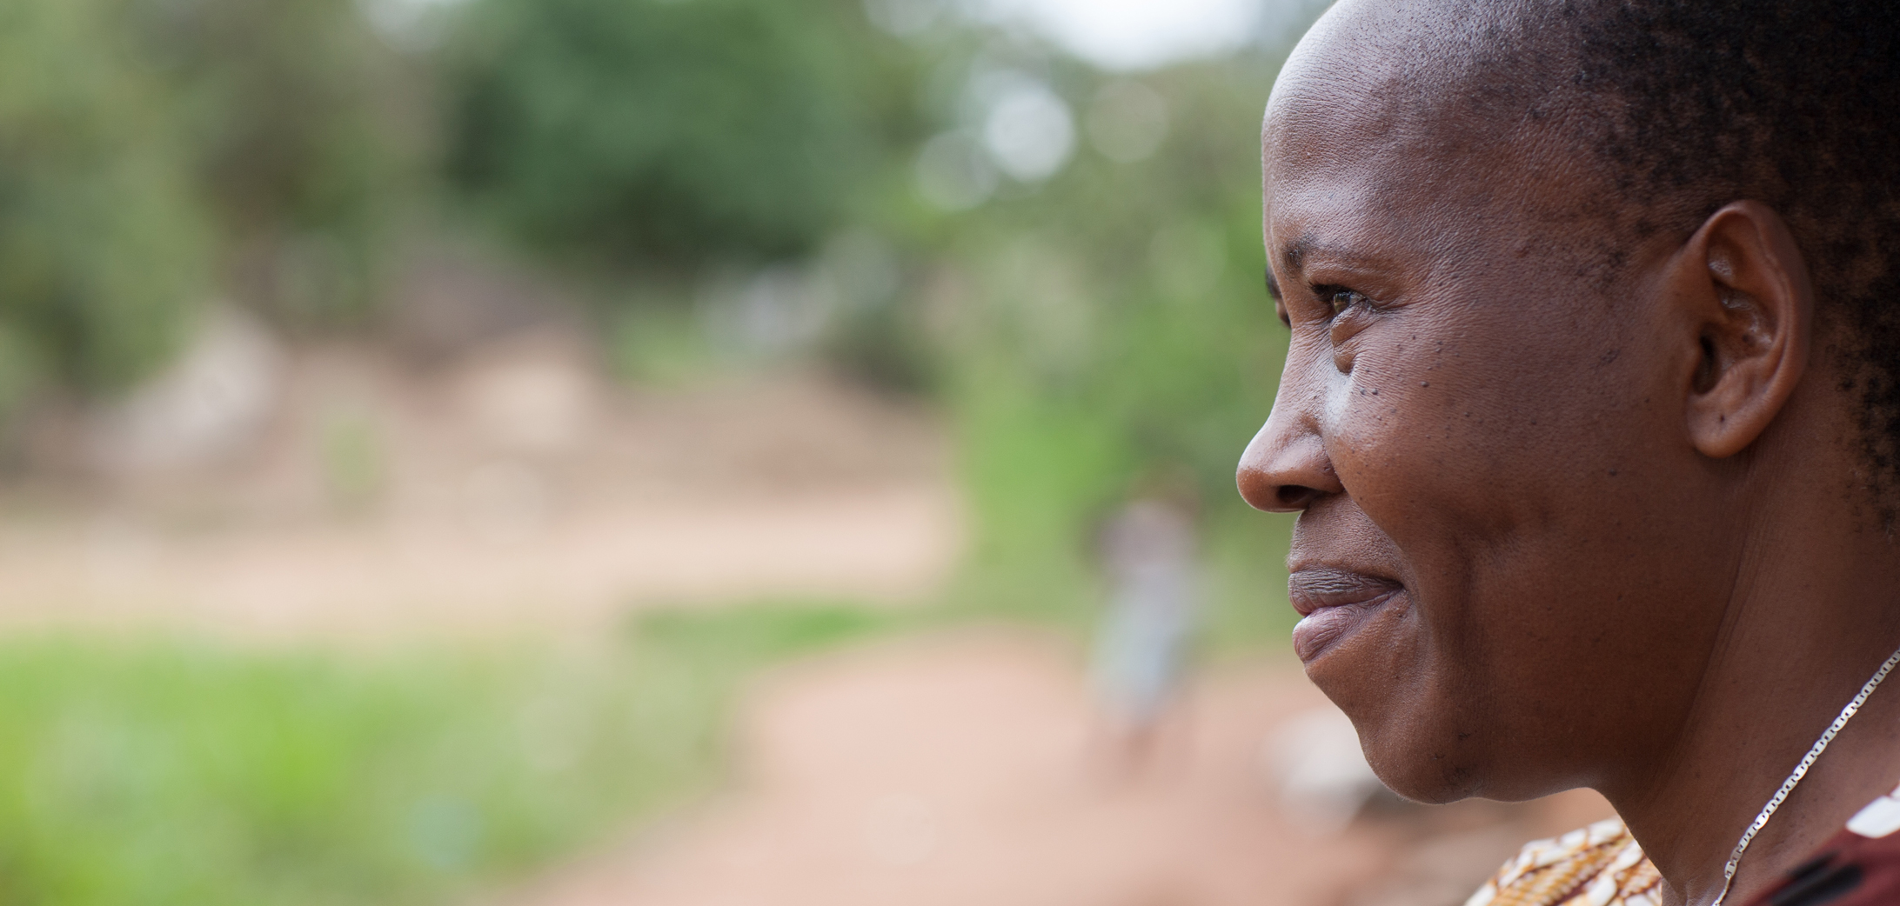





Thank you
www.raisingvoices.org
www.genderviolence.lshtm.ac.uk

